Slide 1
Incident Management System (IMS)
Project Title:
Group Member name Roll no:
Khan Mohammed Kaif 230825
Khan Daniyal 230824
Khan Sara 230839
Shaikh Armaan 230842

Slide 2

Contents Include:
Overview of project
Existing System
Proposed System
Problem Statement
Objective and Scope of the project
System Requirements: Hardware, Software
Seminar Topics
Seminar Topic Explanation
Conclusion

Slide 3
Overview of Incident Management System (IMS)
An Incident Management System (IMS) is a structured process or software used by organizations—especially in IT, security, and operations—to identify, record, analyze, and resolve incidents (problems, errors, or disruptions) quickly and efficiently.
Main Purpose:
The main goal of IMS is to:
Restore normal service operations as fast as possible.
Minimize the impact of incidents on business operations.
Ensure service quality and reliability.
How It Works
Incident Detection:
The system detects an issue automatically or through user reports (e.g., network failure, application crash).
Alert & Logging:
The system logs all details and sends alerts to the IT support team.
Classification & Prioritization:
Incidents are categorized based on severity and impact (e.g., critical, high, medium, low).
Investigation & Diagnosis:
The team analyzes the root cause and finds a possible solution.
Resolution & Recovery:
The problem is fixed, and services are restored.
Closure & Documentation:
The incident is closed after confirmation, and all details are documented for future reference.

Slide 4
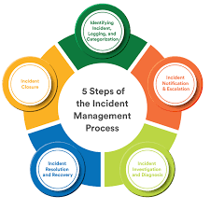
Existing System
The existing system refers to the current way incidents are handled in an organization before implementing a structured Incident Management System. It often involves manual or semi-manual processes.
Characteristics of the Existing System
Manual Reporting:
  Users report issues through phone calls, emails, or in-person requests.
  No centralized tracking system exists.
No Standardized Process:
  Each IT support staff may handle incidents differently.
  Prioritization of incidents is inconsistent.
Delayed Response:
  Incident detection relies on users noticing problems.
  IT teams may not be aware of issues until they are reported.
Problems in the Existing System
High downtime due to delayed detection and resolution.
User frustration because
issues take long to resolve.
Inefficient resource utilization of IT staff.
No data for analysis or preventive measures.

Slide 5
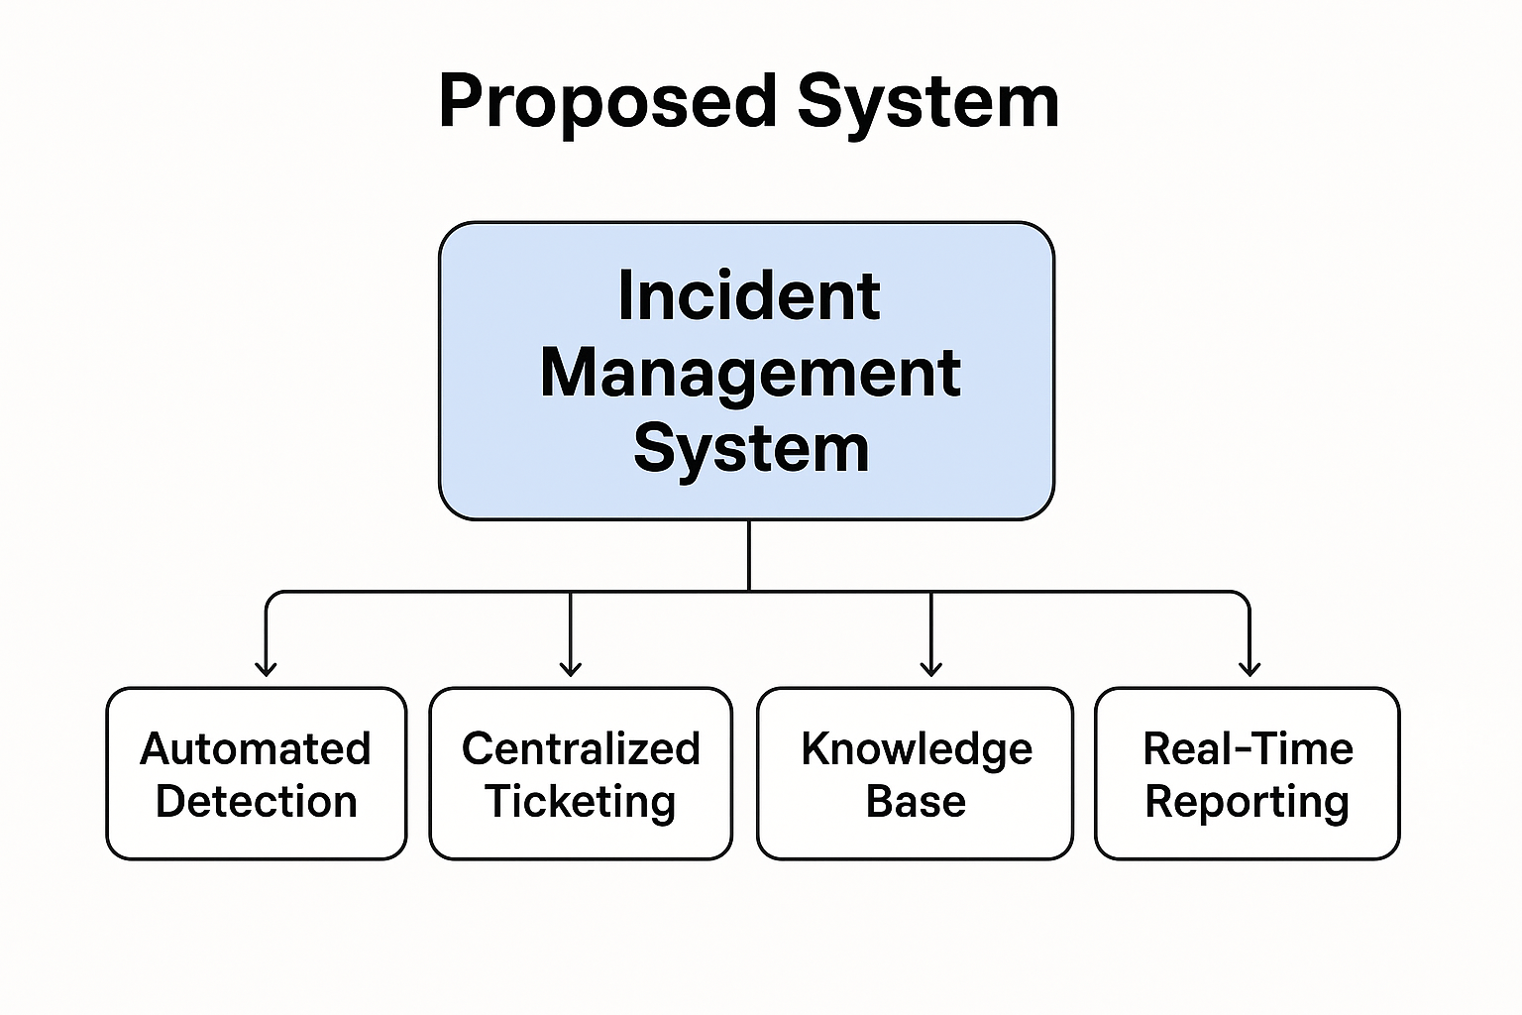
Proposed System
The proposed system is a modern, automated Incident Management System designed to efficiently detect, record, manage, and resolve incidents in an organization. Unlike the existing manual system, this system uses structured workflows, automation, and real-time monitoring to reduce downtime and improve service quality.
Key Features of the Proposed System
1. Automated Incident Detection
  The system can automatically detect issues in IT systems, networks, or applications.
  Alerts are sent to the responsible teams instantly.
2. Centralized Ticketing System
  All incidents are recorded as tickets in a centralized database.
  Each ticket has details like severity, status, priority, and assigned personnel.
3. Prioritization and Categorization
  Incidents are categorized (hardware, software, network, etc.) and prioritized (critical, high, medium, low).
4. Automated Notifications and Escalation
  IT staff are notified immediately when incidents occur.
  If not resolved in time, the system automatically escalates to higher-level support.

Slide 6
Problem Statement
In many organizations, IT systems and business operations are prone to unexpected incidents such as hardware failures, software errors, security breaches, or service interruptions. Currently, incident reporting and resolution are often manual, unstructured, and time-consuming. This leads to delayed detection, inefficient tracking, inconsistent communication, and prolonged downtime, which negatively impacts productivity, customer satisfaction, and overall business performance.
There is a need for an automated Incident Management System that can efficiently record, track, prioritize, and resolve incidents. The system should provide real-time alerts, streamline communication among IT staff, maintain a history of incidents for analysis, and ensure timely resolution to minimize business disruption.

Slide 7
Objective and Scope
Objectives of IMS
Efficient Incident Logging: Allow users to quickly report incidents with all relevant details.
Prioritization & Categorization: Classify incidents based on severity, impact, and urgency to ensure critical issues are addressed first.
Real-Time Tracking: Enable IT teams to monitor the status of incidents from reporting to resolution.
Timely Resolution: Reduce downtime by providing tools and workflows for fast and effective problem-solving.
Automated Notifications & Alerts: Notify responsible personnel immediately when an incident occurs or escalates.
Knowledge Management: Maintain a record of past incidents and solutions to facilitate faster resolution in the future.
Reporting & Analysis: Generate reports on incident trends, response times, and system performance for informed decision-making.
Scope of IMS
User Access: Accessible to employees to report incidents and to IT staff for managing and resolving them.
Incident Management Lifecycle: Covers all stages – logging, categorization, assignment, escalation, resolution, and closure.
Multi-Channel Reporting: Users can report incidents via web portal, email, or mobile app.
Prioritization & SLA Management: Assigns priority based on impact and urgency and tracks compliance with Service Level Agreements (SLAs).
Integration with IT Infrastructure: Can integrate with monitoring tools, email systems, and IT asset databases for automated alerts.
Analytics & Reporting: Provides dashboards, metrics, and historical data for management review.
Scalability: Can be extended to handle incidents across multiple departments or locations.

Slide 8
SYSTEM REQUIREMENT
Hardware:
Software:
Component | Minimum Requirement | Recommended
Processor | Intel i3 or equivalent | Intel i5 or higher
RAM | 4 GB | 8 GB or higher
Hard Disk | 100 GB | 250 GB or higher
Network | 1 Mbps internet | 10 Mbps or higher
Server | Single server for small setups | Multi-server environment for large organizations
Component | Requirement
Operating System | Windows 10/11, Linux (Ubuntu/CentOS), or macOS
Web Server | Apache, Nginx, or IIS
Database | MySQL, PostgreSQL, or MS SQL Server
Programming Languages | PHP, Python, Java, or Node.js
Browser | Chrome, Firefox, Edge (latest versions)

Slide 9
Seminar Topics
Name Topic Name
Khan Mohammed Kaif Zero Trust Architecture: A New Security Paradigm
Khan Daniyal
Khan Sara
Shaikh Armaan

Slide 10
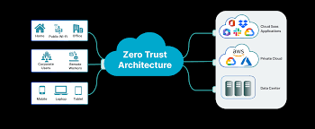
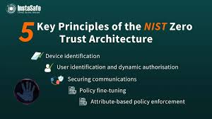
Seminar Topic Explanation
Introduction
Traditional network security relies on the “trust but verify” model, where users and devices inside a corporate network are often trusted by default. However, with the rise of cloud computing, remote work, mobile devices, and sophisticated cyber threats, this perimeter-based security approach is no longer sufficient. Zero Trust Architecture (ZTA) is a modern security paradigm designed to address these challenges.
Core Principle
The core principle of Zero Trust is “Never trust, always verify.”
No user or device is trusted by default, regardless of whether they are inside or outside the network perimeter.
Access to resources is granted only after verifying identity, device health, and security posture, and is limited to the minimum necessary privileges.

Slide 11
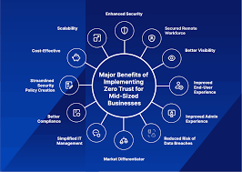
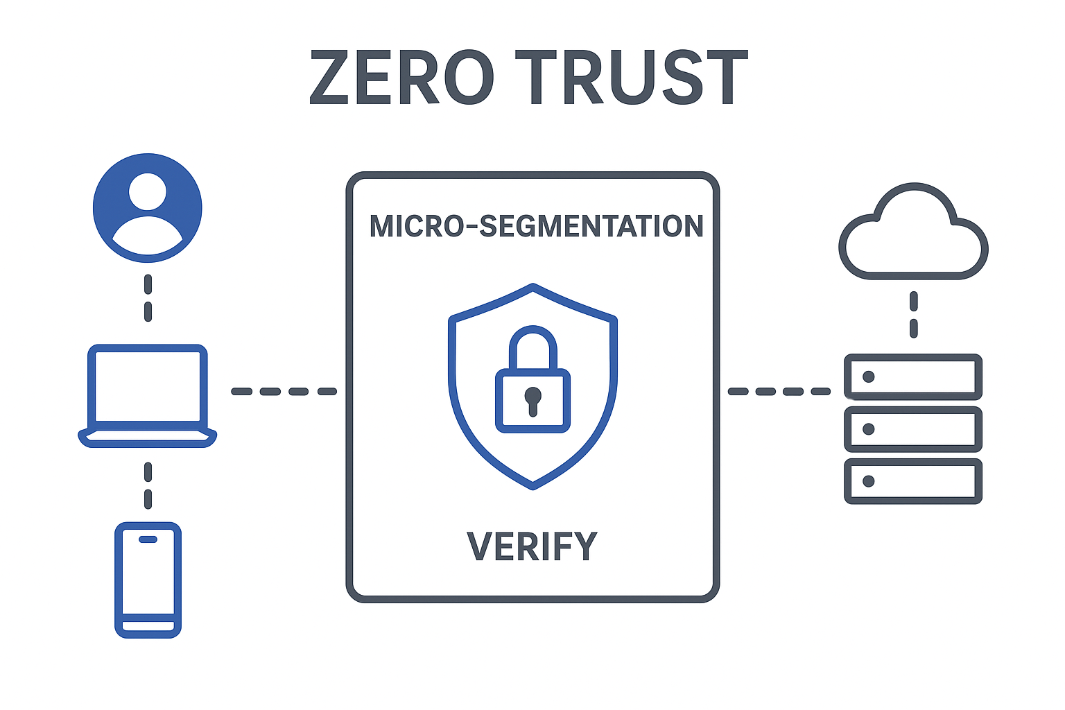
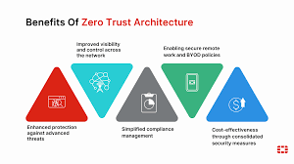
Benefits of Zero Trust
Reduces the risk of insider threats and external attacks.
Limits data breaches and lateral movement of malware.
Provides better visibility into user activity and network traffic.
Supports remote work and cloud adoption securely.

Slide 12

Q&A Session
What is an Incident Management System (IMS)?
How does a computer network work?
What is Zero Trust Architecture?

Slide 13

Thank you
Khan Kaif
9326865523

